Slide 1

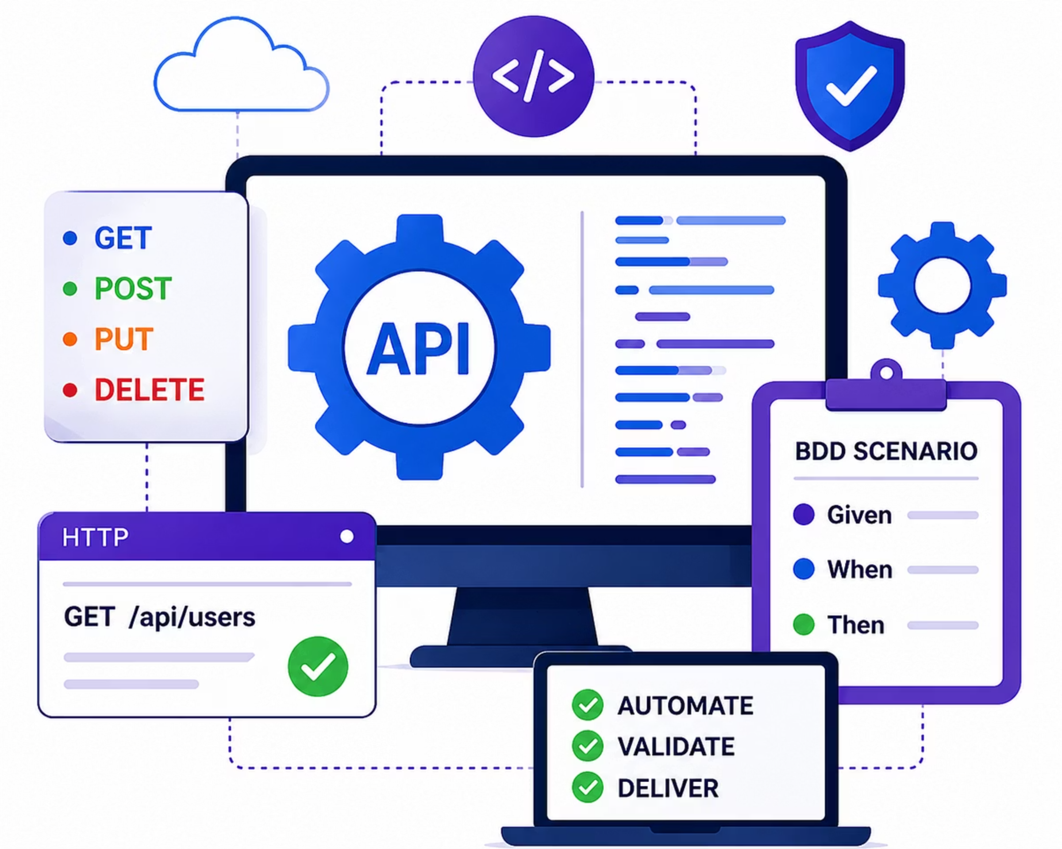

Precision API BDD Automation Framework
Java · REST Assured · Cucumber · Maven
VEEVA SYSTEMS · MAY- 2026
MVVNSM CHANDANA
KADIMI HARIKA

Slide 2
Contents
1
Problem Statement
2
Project Objectives
3
Technology Stack
4
Framework Architecture
5
Project Folder Structure
6
Framework Design Patterns Used
7
Test Scenario Demonstration
8
Code Walkthrough
9
Execution, Reporting & Version Control
10
Conclusion & Future Scope

Slide 3
The Problem with Manual API Testing
⏱ Slow
⚠️ Error-Prone
🔗 Hard to Chain
📉 Low Coverage
Doesn't keep up with sprint speed.
Repetitive checks lead to mistakes.
Cross-endpoint flows are difficult to manage.
Edge cases and failures get missed.

Slide 4

Objectives
Automate REST API Testing
Implement BDD with Cucumber
Validate Edge Cases
Negative testing, error handling, cross-endpoint consistency
CRUD operations + API chaining with REST Assured
Gherkin scenarios: readable by devs, QA, and stakeholders
Generate Reports
Extent, Cucumber, and Surefire reports for every run

Slide 5






Technology Stack
REST Assured
Java 21
HTTP request creation & response validation
Core language for all automation logic
Git / GitHub
Cucumber
Version control & project collaboration
BDD scenarios in Gherkin Given-When-Then
Postman
Maven
Manual validation & environment setup
Dependency management · mvn clean test

Slide 6
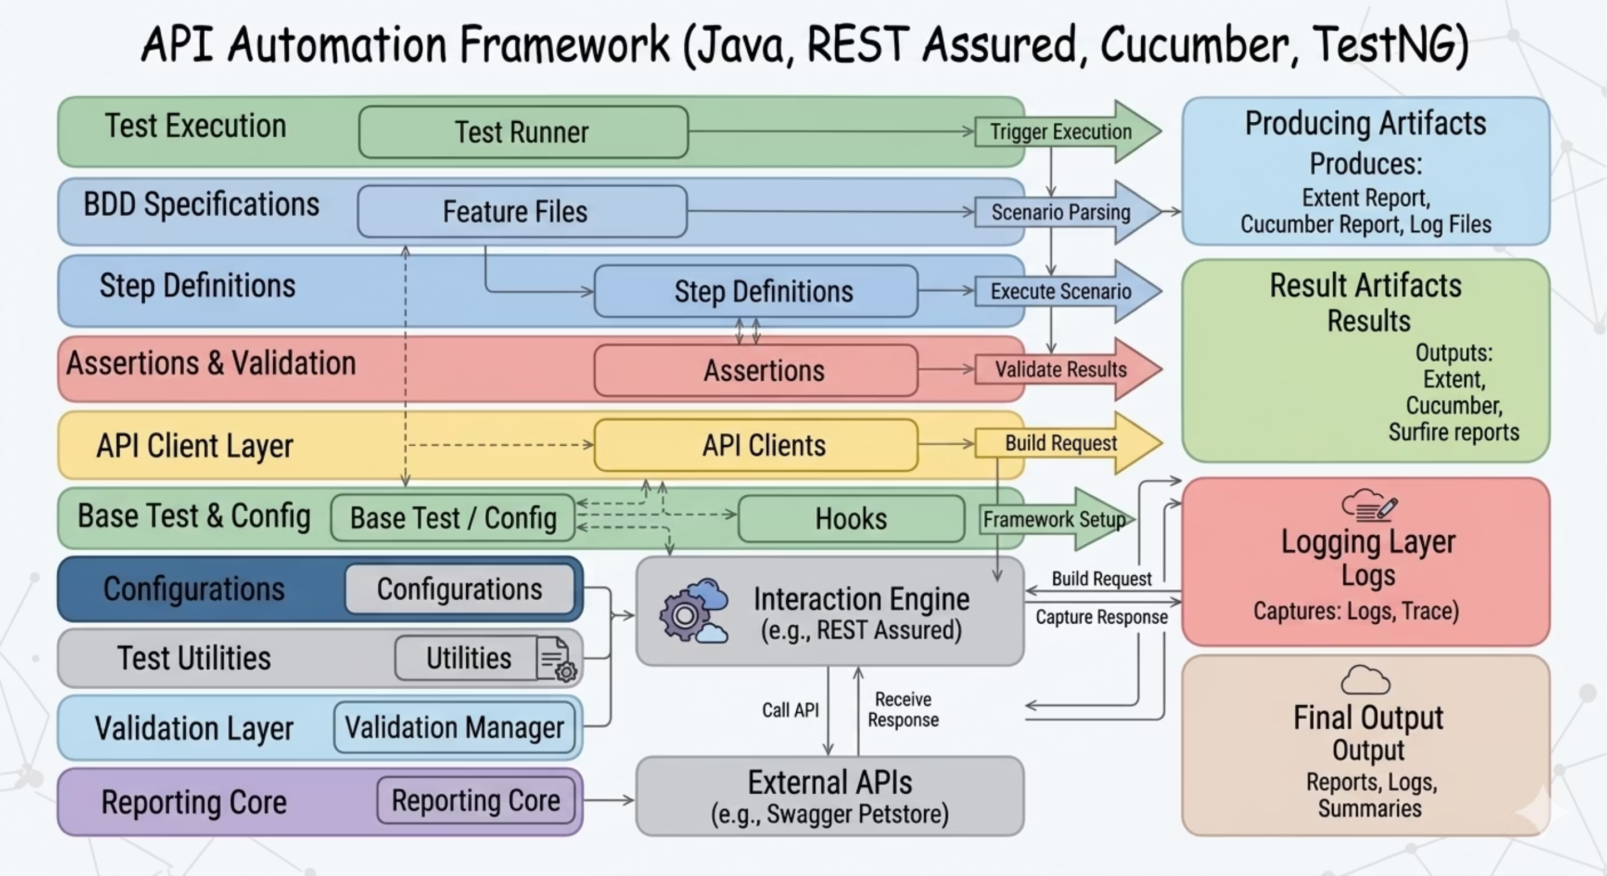
Framework Architecture
Each layer owns a single responsibility — from scenario declaration down to HTTP execution — enabling maintainability and reuse across the entire suite.

Slide 7
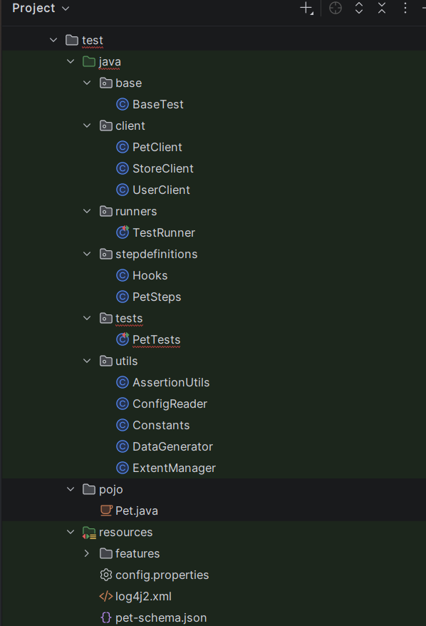
Project Folder Structure
Source Layout
Design Patterns Used
Page Object (API Client)
Singleton (Base Config)
Encapsulates all REST Assured calls in reusable client classes
Single config instance shared across all test classes
Factory Pattern
Builds request specifications dynamically from config

Slide 8
Test Scenario Demonstration
Pet Lifecycle — CRUD & API Chaining
Inventory Analysis — Complex Parsing
User Security — Negative Testing
POST → GET → PUT → DELETE → GET (expect 404). Extracts pet ID dynamically and chains all operations end-to-end.
GET /store/inventory → parse "available" count → GET /pet?status=available → cross-validate counts match.
Invalid email creation · 404 on non-existing user · failed login with bad credentials.
Cross-Endpoint Consistency
Create pet → update status to "sold" → retrieve sold list → confirm pet ID present using dynamic loop.

Slide 9
Code Walkthrough
Feature File (Gherkin)
Key Implementation Highlights
Dynamic ID extraction via response.jsonPath().getInt("id")
Scenario: Pet Lifecycle CRUD
Given I create a new pet "Buddy"
When I retrieve the pet by ID
Then the pet name should be "Buddy"
When I update the pet status to "sold"
And I delete the pet
Then the pet should return 404
RequestSpecification reused across all client methods — no duplication
Hooks handle setup/teardown; BaseTest loads config.properties
API Client (REST Assured)
Assertions use both REST Assured body() matchers and TestNG assertEquals
public Response createPet(String name) {
return given()
.spec(requestSpec)
.body(buildPayload(name))
.when()
.post("/pet")
.then()
.statusCode(200)
.extract().response();
}

Slide 10

Execution, Reporting & Version Control
1
🚀 Run Suite
2
📊 Extent Report
3
🥒 Cucumber Report
mvn clean test
Rich HTML dashboard — pass/fail, timing, step-level details
Scenario-by-scenario BDD execution summary
TestRunner triggers all feature files in one command
4
📁 Surefire
5
🔀 Git / GitHub
target/surefire-reports — CI/CD compatible XML + HTML
Incremental commits · structured repo · full project history
GitHub: veeva-automation-engineer-roadmap · API Reference: petstore.swagger.io

Slide 11

Conclusion & Future Scope
What Was Achieved
Future Enhancements
Production-grade BDD framework from scratch
4 end-to-end scenarios covering CRUD, chaining, negative, and cross-endpoint validation
Modular, reusable, CI-ready architecture
Data-driven testing via external Excel / CSV
CI/CD pipeline integration (Jenkins / GitHub Actions)
Parallel execution with TestNG thread pools
Contract testing with Pact
This framework serves as a scalable foundation for enterprise API automation — interview-ready, industry-aligned, and built to grow.

